Slide 1
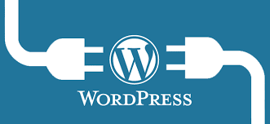
Must-Have WordPress Plugins
Marcie Hill | Writer * Blogger * Trainer * Author
www.marciewrites.com @Marcie_Hill

Slide 2
Our Lessons Today
What are Plugins?
Where to Find Plugins
How to Choose Plugins
10 Must-Have Plugins

Slide 3
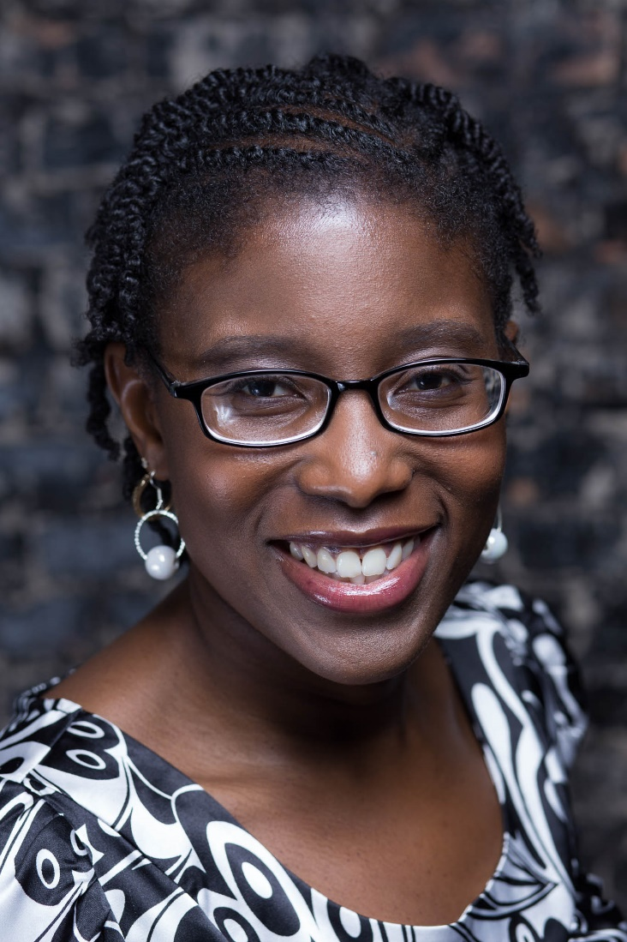
About Me
Author
Writer
Blogger
Trainer

Slide 4
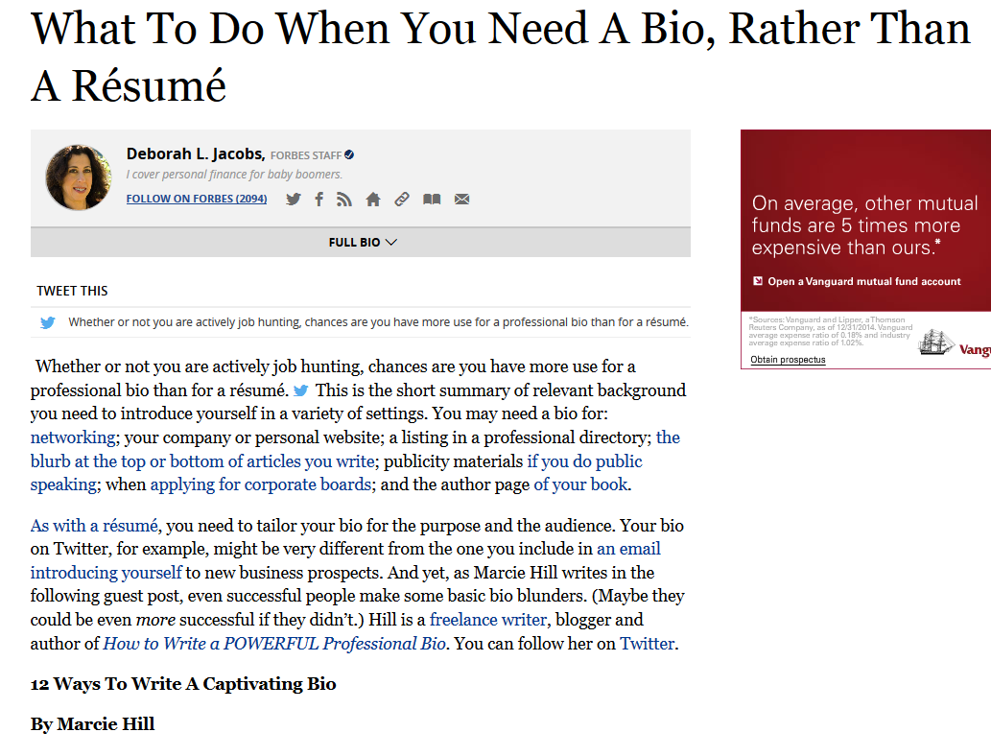
Writer & Blogger
200+ articles
3500+ blog posts
Greatest Accomplishments

Slide 5
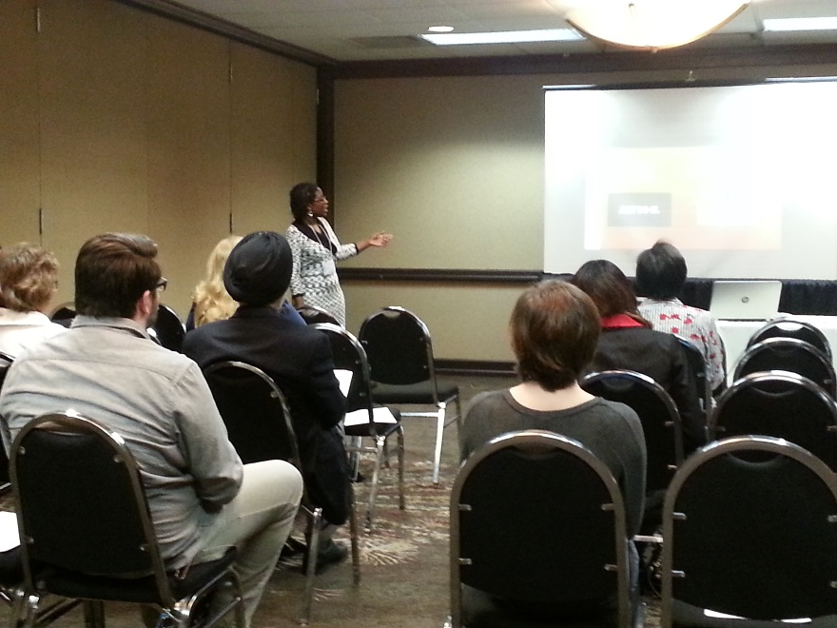
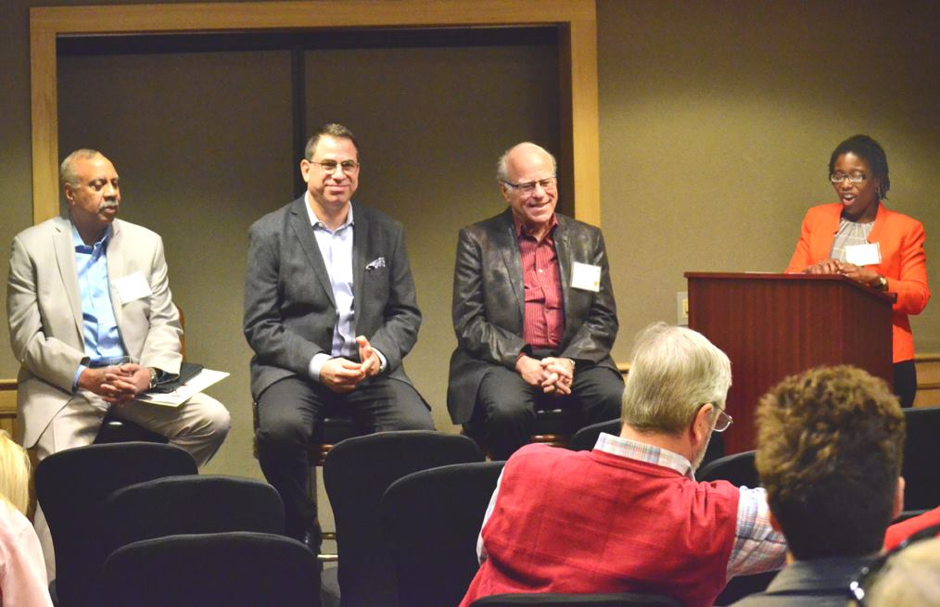
Trainer
Software trainer
Conference presenter
Panel moderator

Slide 6
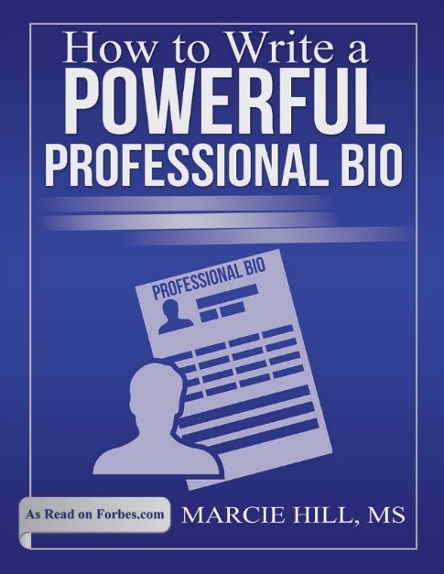
Author

Slide 7
What is a Plugin?
A bit of code that “plugs in to your
self-hosted WordPress site….
that adds new functionality…or extends
functionality to your site.
Source: kinsta.com

Slide 8
Considerations
Security vulnerabilities
Site crashes
Page loading speed

Slide 9
Choosing Plugins
Need
Ease of Use
Cost
Date of last update
Compatibility
Ratings

Slide 10
Where to Find Plugins
Wordpress.org
CodeCanyon
WPMU Dev
iThemes
Pick Plugins
Theme companies

Slide 11
Must-Have Plugins

Slide 12
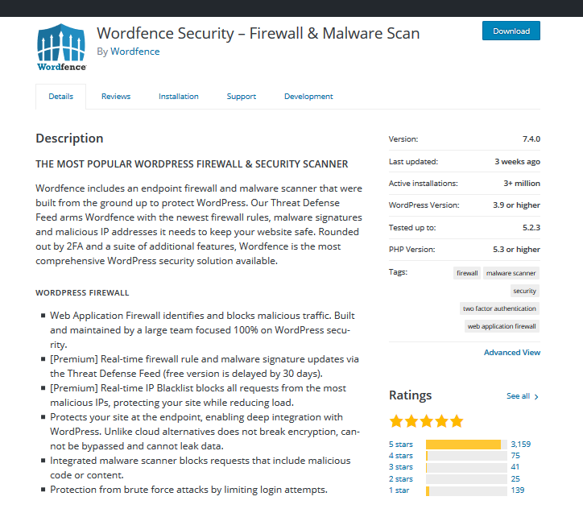
Security

Slide 13
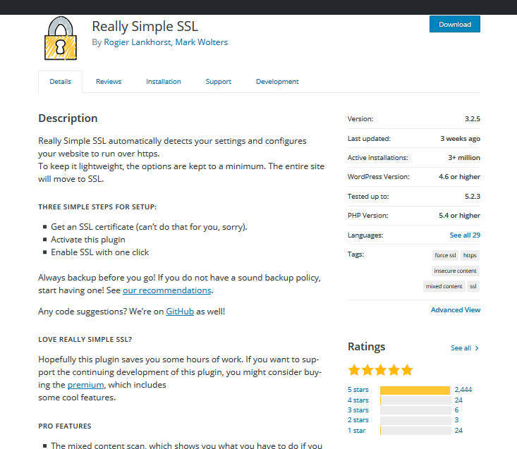
Add https

Slide 14
Spam Protection

Slide 15
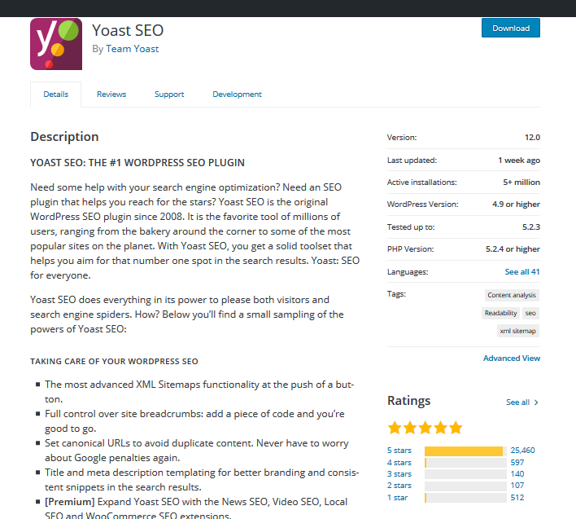
SEO

Slide 16
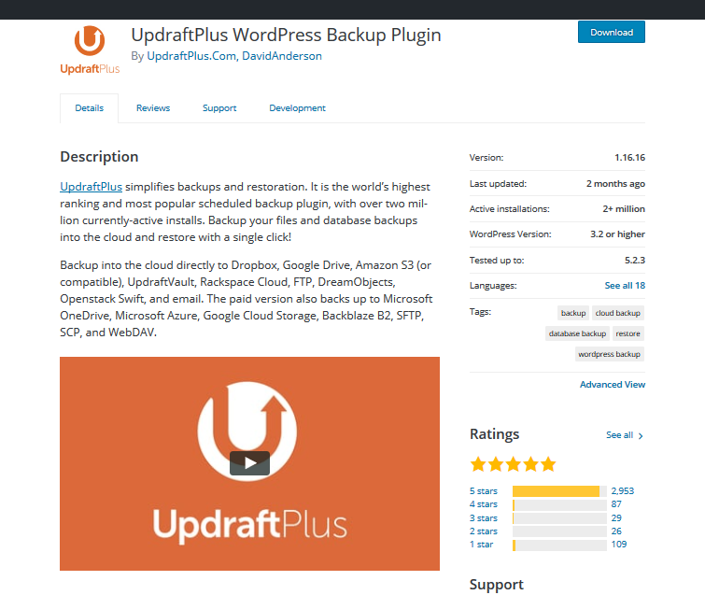
Site Backup

Slide 17
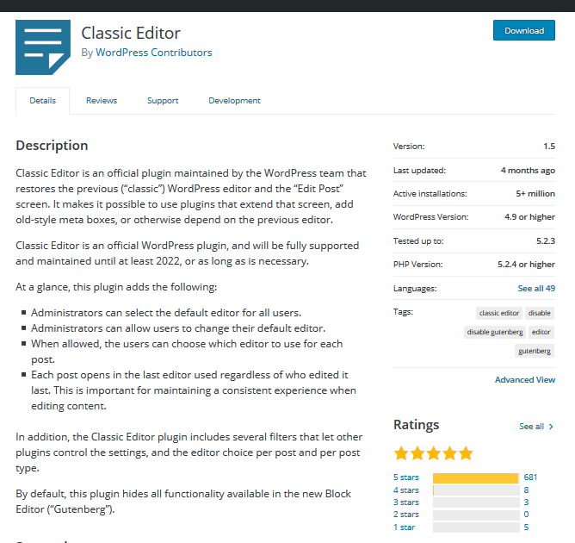
Editor

Slide 18
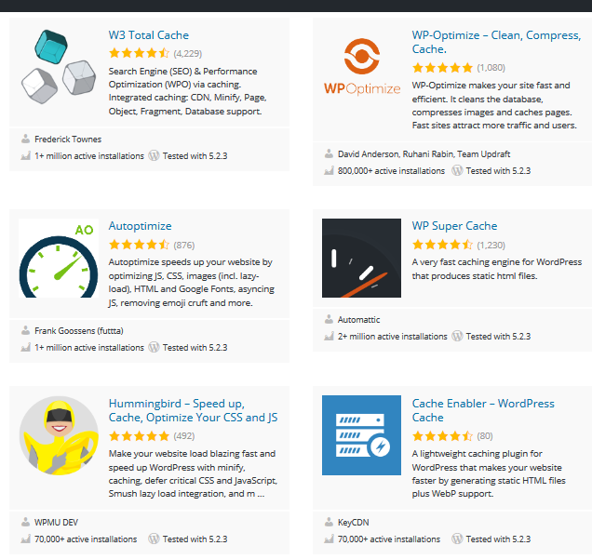
Cache

Slide 19
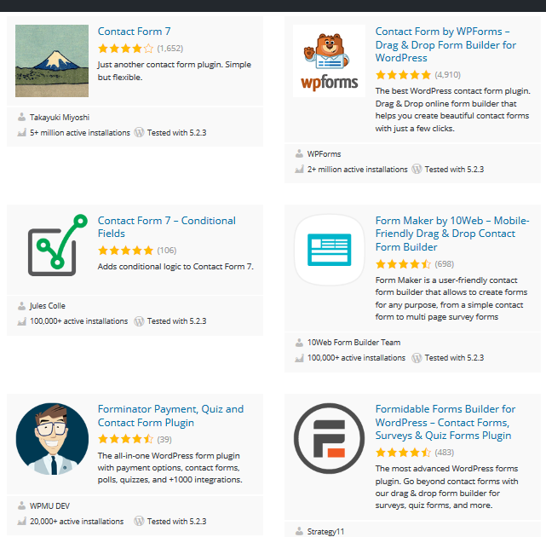
Contact Forms

Slide 20
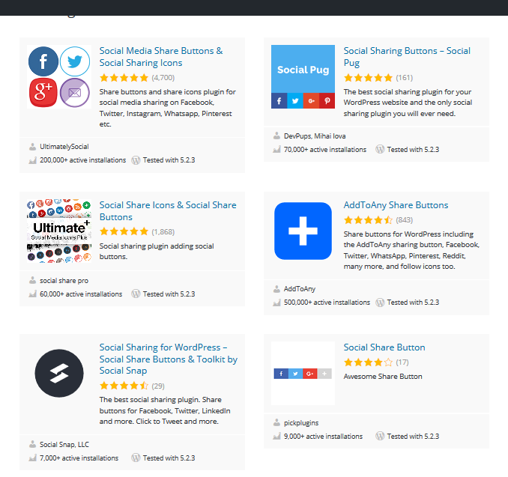
Social Share Buttons

Slide 21
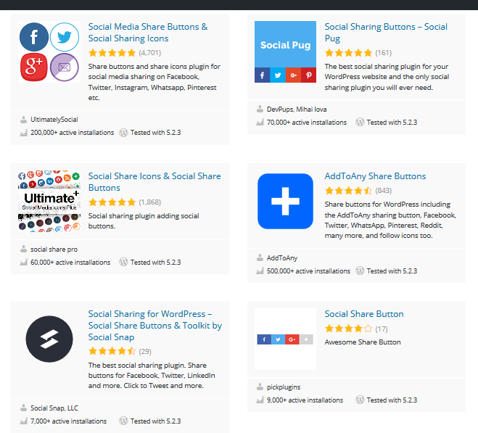
Social Media Post Scheduler

Slide 22
Nice to Have
Duplicate Post
Export All URLS
Editorial Calendar
Ecommerce

Slide 23
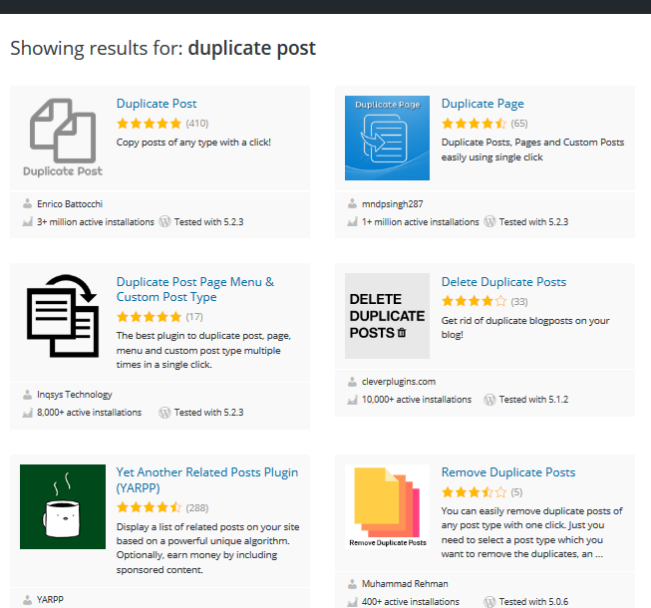
Duplicate Post

Slide 24
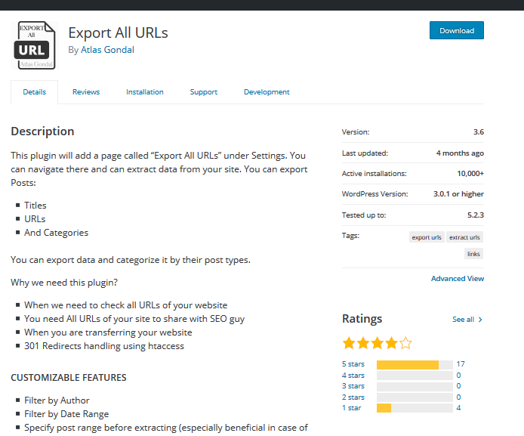
Export All URLS

Slide 25
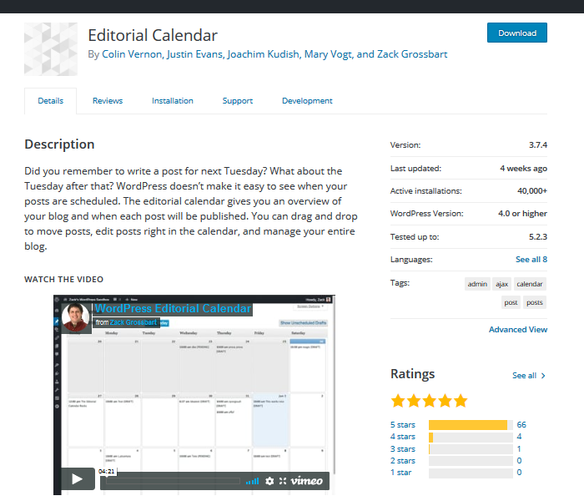
Editorial Calendar

Slide 26
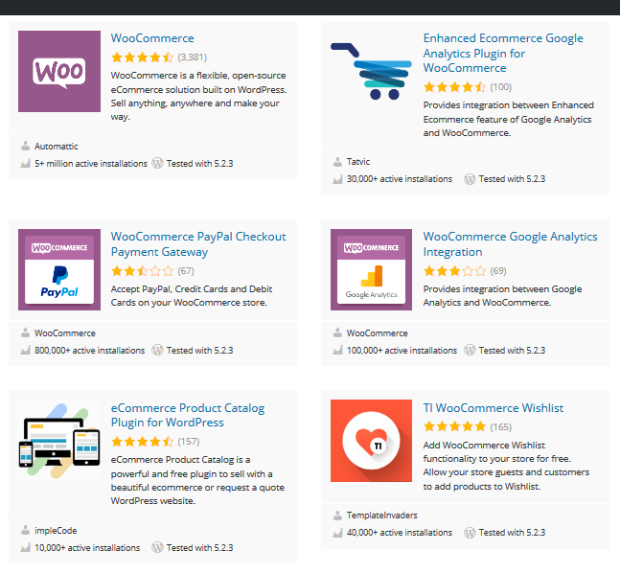
Ecommerce

Slide 27
Recap
What are Plugins?
Where to Find Plugins
How to Select Plugins
10 Must-Have Plugins

Slide 28
Questions

Slide 29
Contact Me
msmarcie@marciewrites.com
Marcie Hill
Marcie_Hill
www.marciewrites.com

