Slide 1
Freelance Ain’t Free
The Do’s and Don’ts of Freelancing for Sites and Publications
Marcie Hill – Writer, Author, Blogger
Author, 62 Blog Posts to Overcome Blogger’s Block
@Marcie_Hill

Slide 2
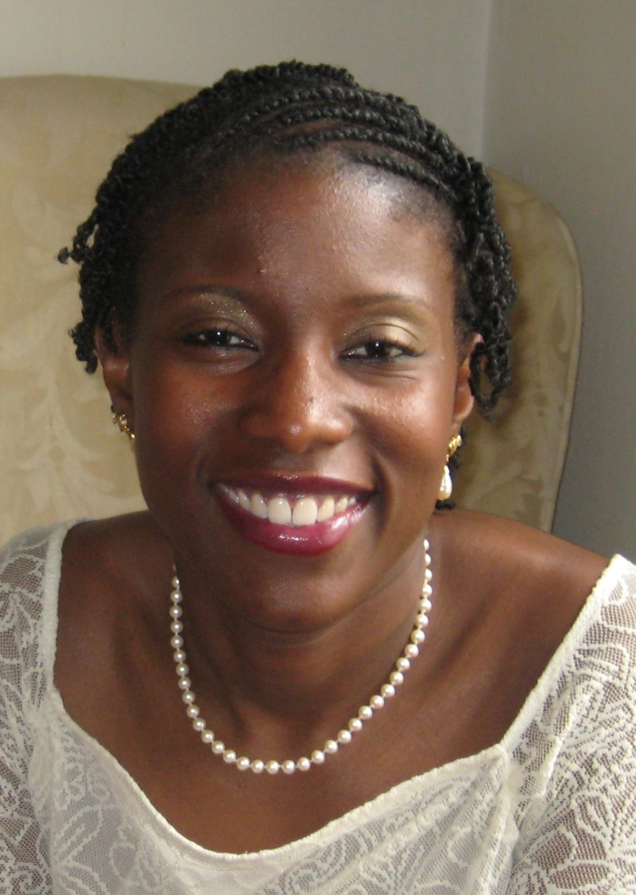
Gifted Writer
Blogger
Author
Speaker

Slide 3
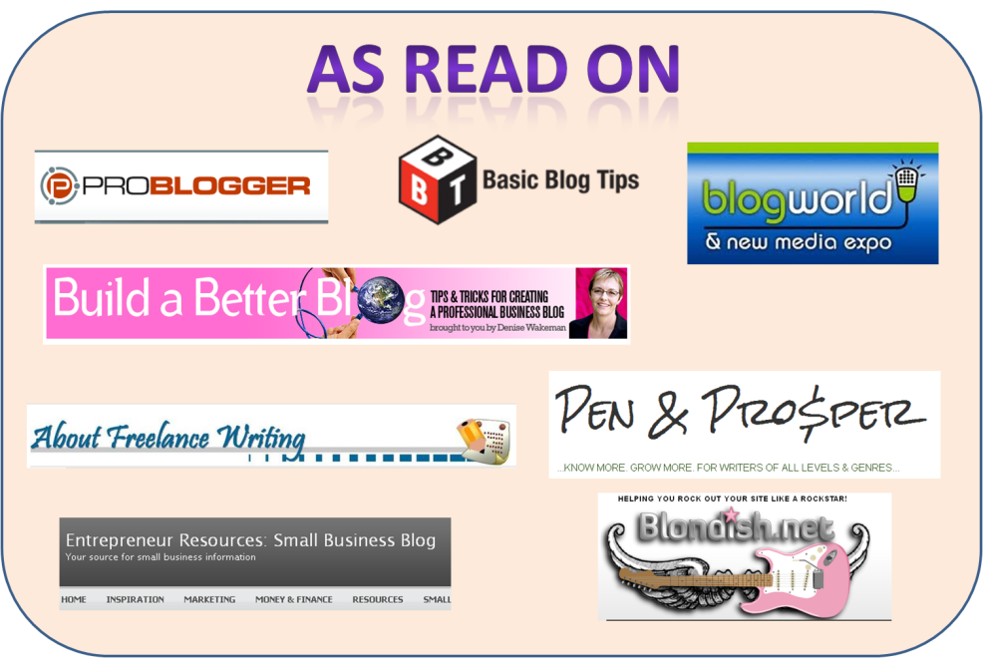

Slide 6
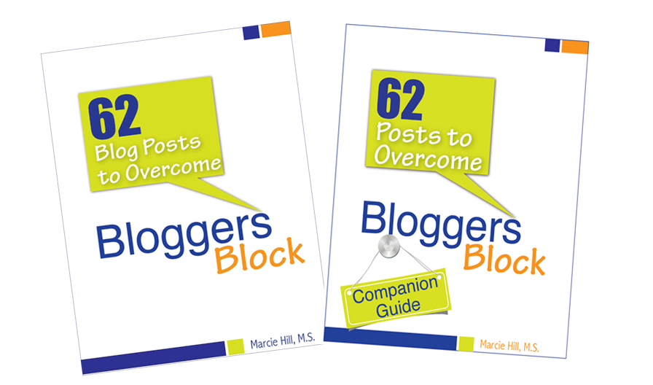
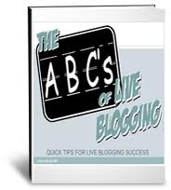
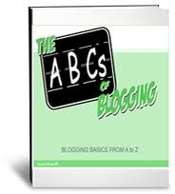
Launching in November 2012

Slide 8
WRITING JOURNEY

Slide 9
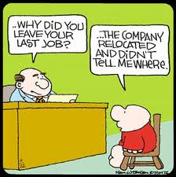

Slide 12
DON’T
Get Discouraged
DO
Keep Moving

Slide 13
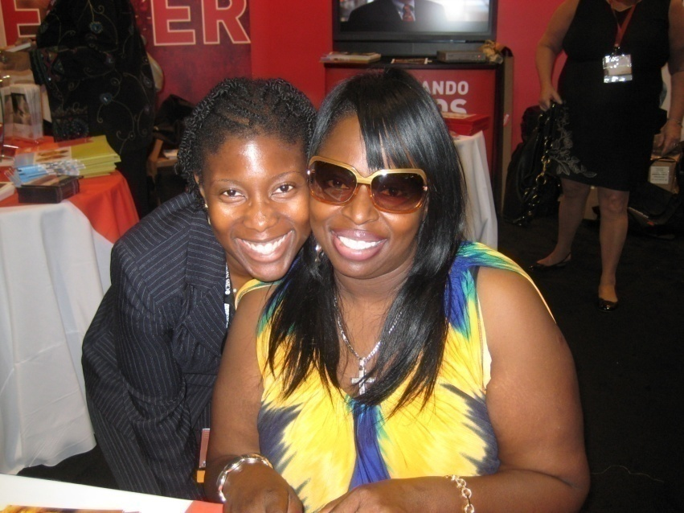
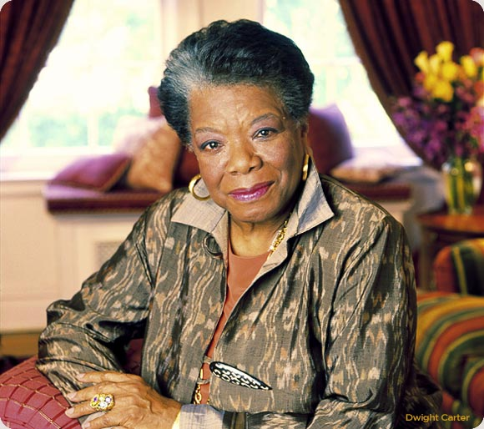

Slide 14
The Do’s and Don’ts
of Freelancing

Slide 15
Why Do You Want to Freelance?
How Committed Are you?

Slide 16
DON’T
Doubt Yourself
DO
Be Realistic

Slide 17
DON’T
Be Cheap With Yourself
DO
Know Your Limitations

Slide 18
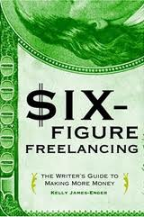
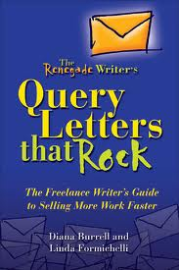
Freelance Resources

Slide 19
Freelance Submission
Process

Slide 20
Read Guidelines
Pitch Story (Query)
Submit Story
Follow Up

Slide 21
Read Guidelines

Slide 22
Read Guidelines

Slide 23
Pitch Story
Read Guidelines
Pitch Story (Query)
Submit Story
Follow Up

Slide 25
Submit
Follow the Guidelines
Ignore doubts & fears

Slide 26
Follow Up
Publication Guidelines
Set Own Guidelines

Slide 27
More Do’s and Don’ts
of Freelancing

Slide 28
DON’T
Assume You Know Publication
DO
Read Publication First

Slide 29
DON’T
Think You Can Write Everything
DO
Specialize in 3-5 Topics

Slide 30
DO
Pitch Your Stories
DON’T
Stop Pitching if Rejected

Slide 31
DON’T
Write What Others Are Writing
DO
Be Original

Slide 32
DO
Write for Free
DON’T
Stay Free

Slide 33
DON’T
Forget to Promote Yourself
DO
Be Confident

Slide 34
DON’T
Go It Alone
DO
Find Help

Slide 35
DON’T
Give Up
DO
Follow Your Dreams

Slide 36
DON’T
Give Up
DO
Follow Your Dreams

Slide 37
To Your Freelance
Success

Slide 38
My Blog Addiction
www.marciewrites.com
www.overcomingbloggersblock.com
www.goshorty.net
www.thewritedesignco.com
www.realskatestories.com

